Slide 1
Classes of Operating Systems
Dept. of Information Technology,
Jadavpur University, Kolkata

Slide 2
Input/Output organization
Involvement of the CPU in I/O operations
  Should be the minimum due to mismatch of CPU and I/O speeds
  CPU should be free to execute instructions while I/O operations are in progress
Different I/O modes
  Programmed I/O
    CPU is involved
  Interrupt I/O
    CPU is partially involved
  Direct memory access (DMA)
    CPU is not involved

Slide 3
Input/Output organization
Hide peculiarities of hardware devices from the user
  General device-driver interface
  Drivers for specific hardware devices
buffering
  storing data temporarily while it is being transferred
caching
  storing parts of data in faster storage for performance
spooling
  the overlapping of output of one job with input of other jobs

Slide 4
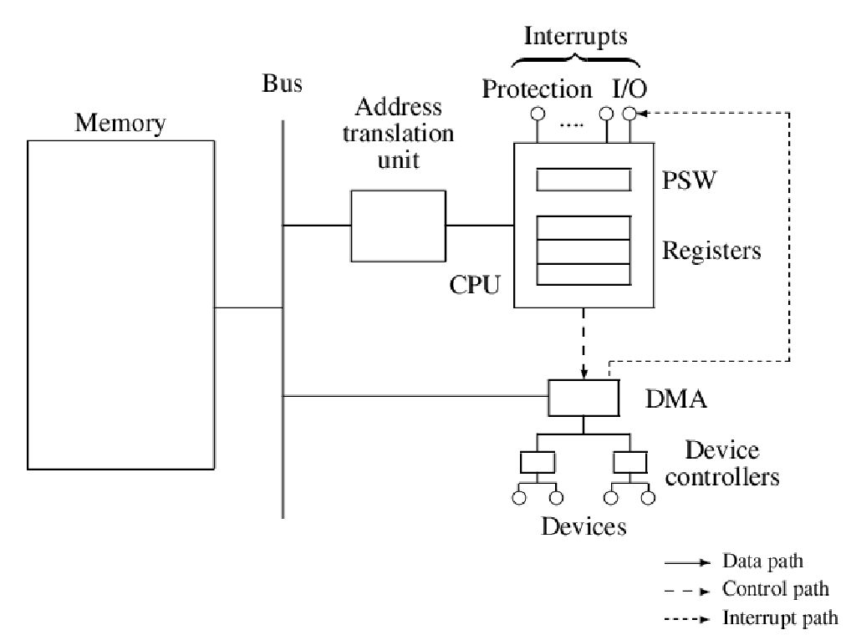
Model of a Computer System

Slide 5
The program status word (PSW)
The CPU contains two kinds of registers
  User accessible registers that are used for arithmetic or logical operations, addressing, indexing, etc. These are called general purpose registers, or simply, CPU registers.
  Control registers, whose contents govern operation of the CPU, such as the condition code register (also called the flags register), program counter, etc.
Control registers are collectively called the program status word (PSW). Individual control registers are considered as fields of the PSW.

Slide 6
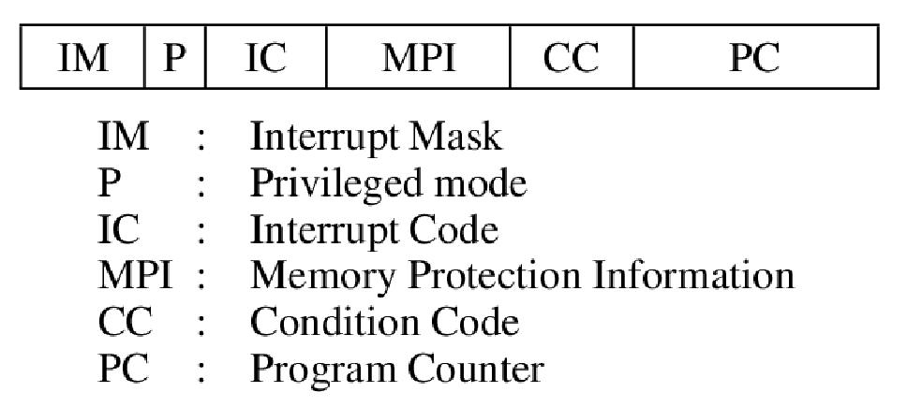
Fields of the Program Status Word (PSW)

Slide 7
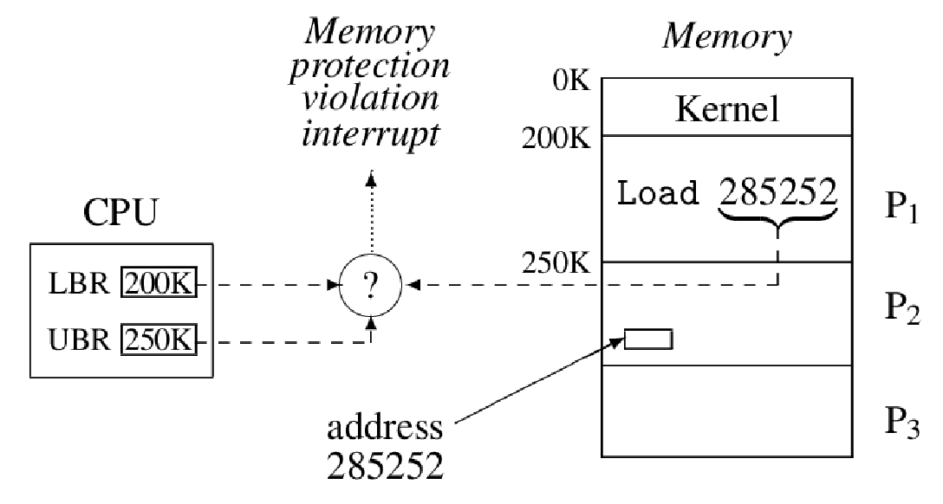
Memory protection using bound registers

Slide 8
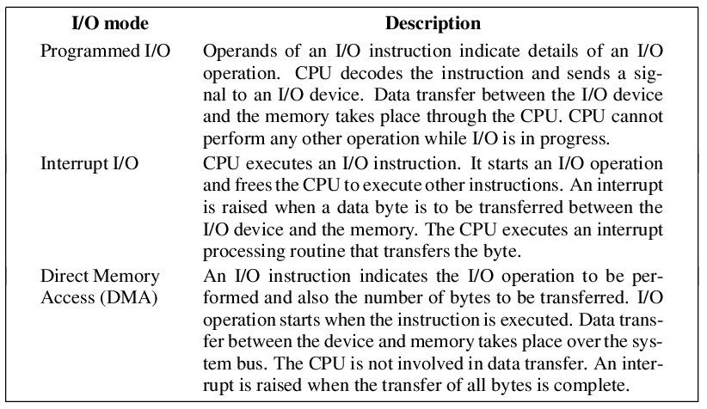
Input Output Modes

Slide 9
Interrupts
An interrupt signals the occurrence of an event to the CPU. The interrupt action is performed when an interrupt occurs.
The CPU is diverted to execution of an OS routine, called the interrupt processing routine
The OS processes the interrupt and decides on subsequent actions
Different classes of interrupts convey occurrence of different kinds of events

Slide 10
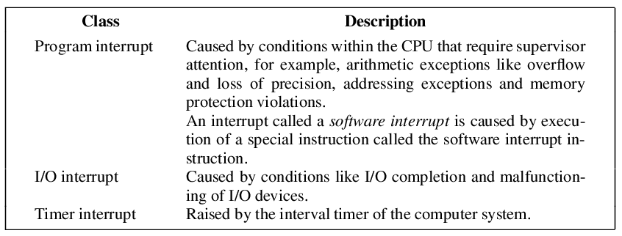
Classes of Interrupts

Slide 11
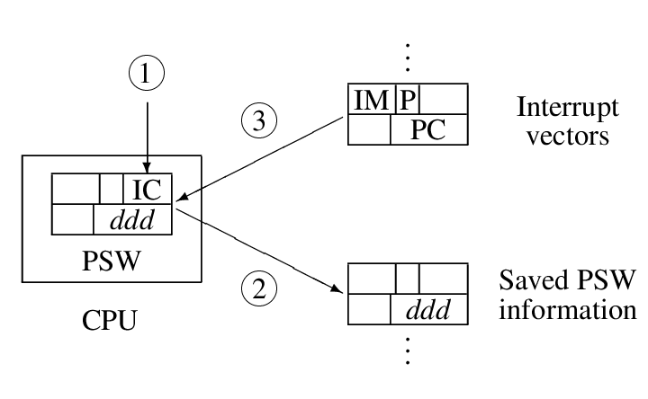
The interrupt action

Slide 12
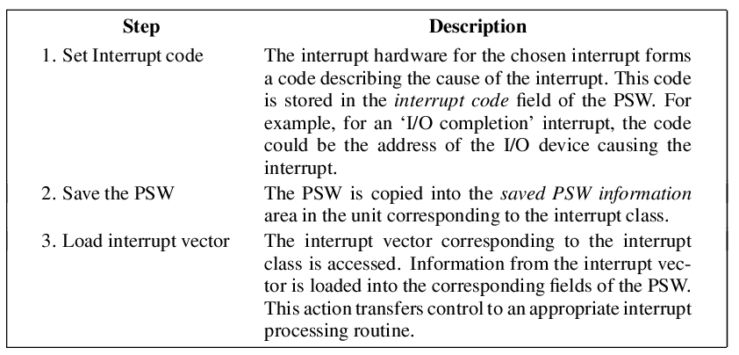
Steps in the interrupt action

Slide 13
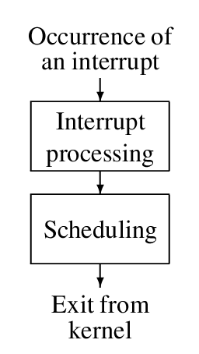
Interrupt driven operation of a kernel

Slide 14
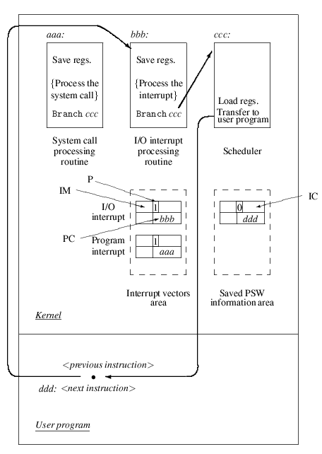

Interrupt processing and scheduling

Slide 15
Nested interrupt
Another interrupt may occur while an interrupt is being processed
CPU would be diverted to process the new interrupt. On completion, processing of the previous interrupt would be resumed
The interrupt mask (IM) indicates whether a new interrupt should be allowed to occur while a previous interrupt is being serviced.
  An interrupt is masked off: it remains pending
  An interrupt is enabled: it can occur

Slide 16
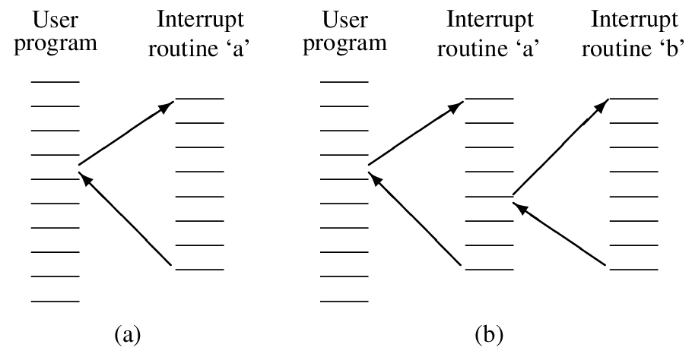
Simple and nested interrupt processing

Slide 17
System Call
A computer has a special instruction called a `software interrupt’ instruction, whose sole purpose is to cause a program interrupt
The operand of the software interrupt instruction becomes the interrupt code
A program uses the software interrupt instruction to make a request to the system; the operand of the instruction indicates what kind of request is being made
This method of making a request is called a system call

Slide 18
Types of system calls
Resource related
  Resource allocation/de-allocation, checking resource availability
Program related
  Execute/terminate program, set or await timer interrupt
File related
  Open/close a file, read/write a record
Information related
  Get time and date, get resource information
Communication related
  Send/receive message, setup/terminate connection

Slide 19
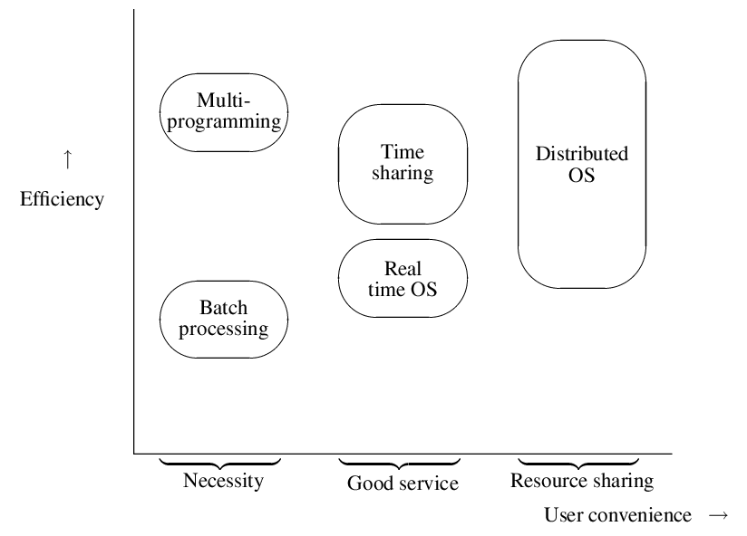
OS classes
Notes:
abcadadad
DPN '04

Slide 20
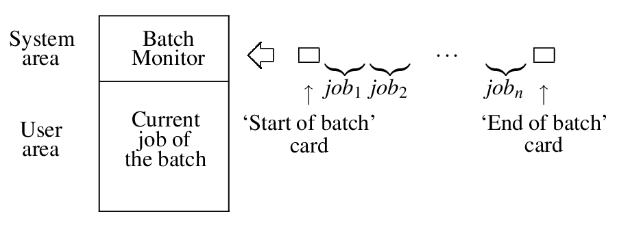
Batch processing system
In early operating systems, the computer operator had to intervene to initiate every job
Aim of batch processing:
  To reduce operator’s intervention in processing of user jobs
Notes:
abcadadad
DPN '04

Slide 21
Batch Processing
Users insert control statements in their jobs to specify
  Start and end of a job, end of program or data
  Requirements concerning execution of a program
The batch monitor processes the control statements to take appropriate actions
  Initiate/terminate processing of a batch
  Initiate/terminate processing of a job
  Protects adjoining programs against interference
    If a program tries to read more data than provided, the end of data card alerts the batch monitor, which terminates the program

Slide 22
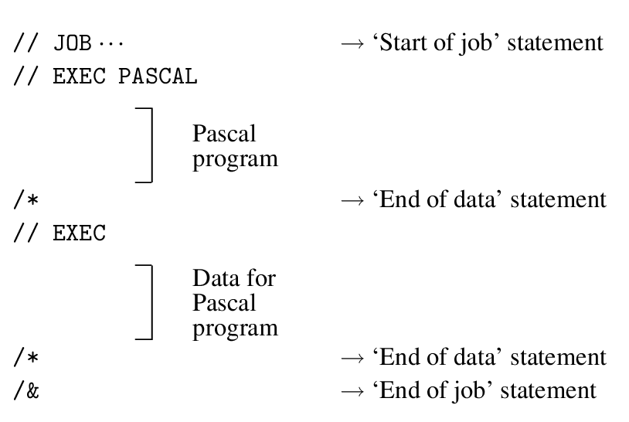
Control statements in IBM 360/370
Notes:
abcadadad
DPN '04

Slide 23
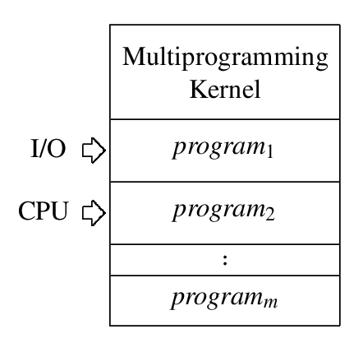
Multiprogramming system
In a batch processing system, the CPU remained idle while a program performed I/O operations
Aim of multiprogramming:
  Achieve efficient use of the computer system through overlapped execution of several programs
Basic Idea
  A subset of total jobs in system is kept in memory
  One job selected and run via job scheduling
  When it waits (for I/O for example), OS switches to another job
Notes:
abcadadad
DPN '04

Slide 24
Functions of a Multiprogramming kernel
Resource allocation and protection
  It uses memory protection to avoid interference between programs
Keeping track of start and end of I/O operations through interrupt processing so that it can
  Initiate I/O operations
  Perform scheduling
Q: How to ensure good performance, measured as throughput of programs?

Slide 25
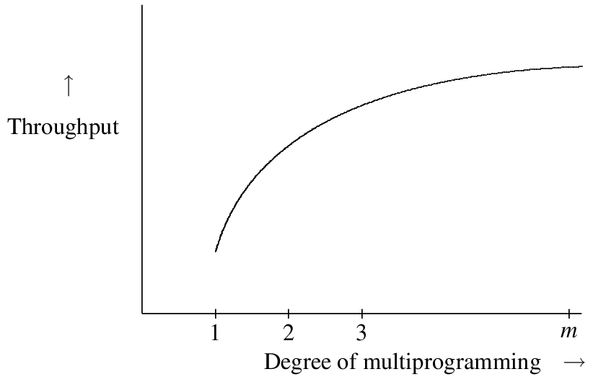
Concepts and techniques
Use a suitable program mix of CPU-bound and I/O-bound programs
  A CPU-bound program performs computations most of the time, and I/O operations seldom
  An I/O bound program performs I/O operations frequently
Assign suitable priorities to programs
  The highest priority programs should always execute on the CPU, unless it is performing I/O operations
Use a suitable degree of multiprogramming
  Degree of multiprogramming = No of programs in memory
Notes:
abcadadad
DPN '04

Slide 26
Priority in a multiprogramming OS
Priority is a tie-breaking rule used to select the program to be executed next, when more than one program is ready for execution
  At any moment, the highest priority program that is not performing an I/O operation should be chosen for execution
Preemptive priority: A low priority program executing on the CPU is preempted, i.e., it is forcefully removed from the CPU, when a high priority program becomes ready for execution.
Q: What is the priority assignment rule?

Slide 27
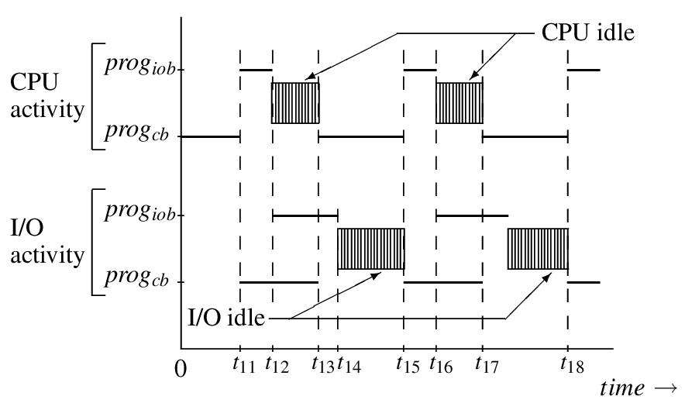
CPU bound program has higher priority
Notes:
abcadadad
DPN '04

Slide 28
CPU-bound program has higher priority
Observations
  CPU utilization is reasonable
  I/O utilization is poor
  Periods of concurrent CPU and I/O activities are rare
Q: Can I/O utilization be improved?
A: No!

Slide 29
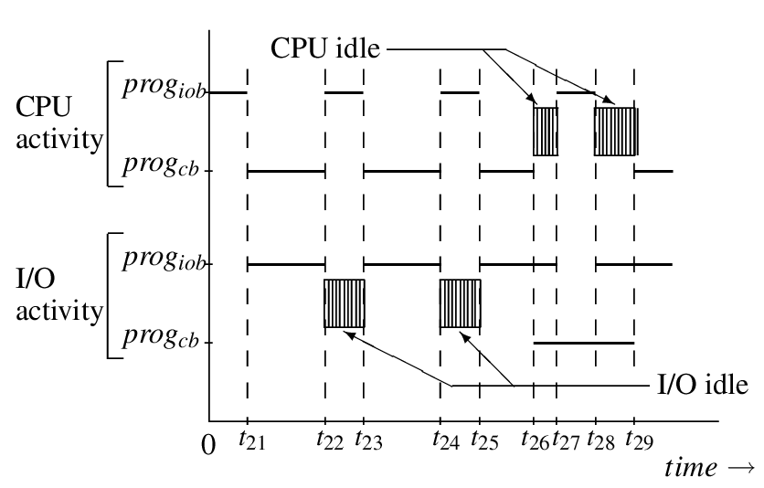
I/O bound program has higher priority
Notes:
abcadadad
DPN '04

Slide 30
I/O-bound program has higher priority
Observations:
  CPU utilization is reasonable
  I/O utilization is reasonable
  Periods of concurrent CPU and I/O activities are frequent
Q: Can CPU and I/O utilization be improved?
A: Yes (How?)

Slide 31
Time Sharing Systems
In interactive computing, users desire good response times to their requests
  Response time to a request is the time since the request is made to the time its results are obtained
A time sharing system provides good response times to programs through
  Round-robin processing of programs
  Using a time slice (δ) to prevent a program from using too much CPU time in one go

Slide 32
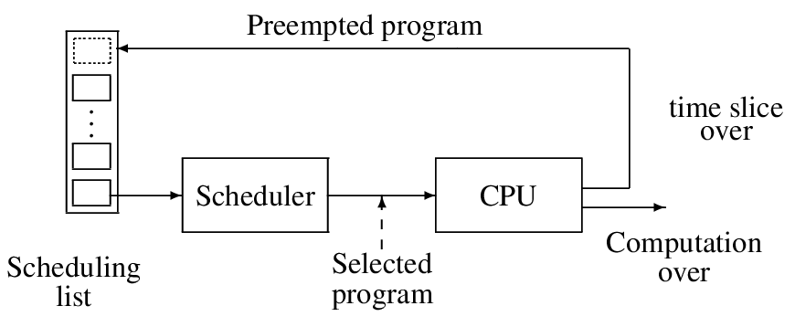
A schematic of round-robin scheduling
Notes:
abcadadad
DPN '04

Slide 33
Time sharing systems
Choice of the time slice depends on two factors
  Response time to programs
  Overhead of switching between programs (σ)
If every program consumes δ CPU seconds before producing a response, response time is
= n_{a}.(δ + σ), where n_{a} is the no of active programs,
and CPU efficiency is = δ/(δ+σ).

Slide 34
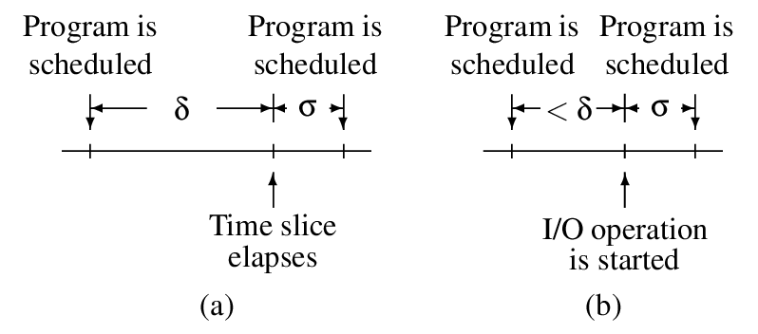
Operation of a time slicing scheduler
Notes:
abcadadad
DPN '04

Slide 35
Influence of δ on response time
δ very small
  A program may need more CPU time than δ to satisfy a request
  Hence a program may have to be scheduled several times before a response can be obtained
  Low efficiency if δ and σ are comparable
  Cache performance may be poor
δ large
  Response time would be better
  Efficiency would be better

Slide 36
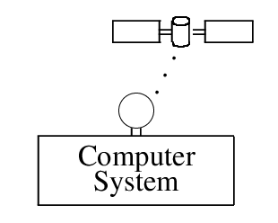
A real time application receiving signals from a satellite

Slide 37
Features of real time operating systems
Permits creation of multiple processes within an application
  So that their overlapped operation can speed up the application
Permits priorities to be assigned to processes
Permits a programmer to define interrupts and interrupt processing routines
Uses priority driven or deadline oriented scheduling
  To meet the application’s time constraints
Provides fault tolerance and graceful degradation
  Such that essential services can be performed in a timely manner

Slide 38
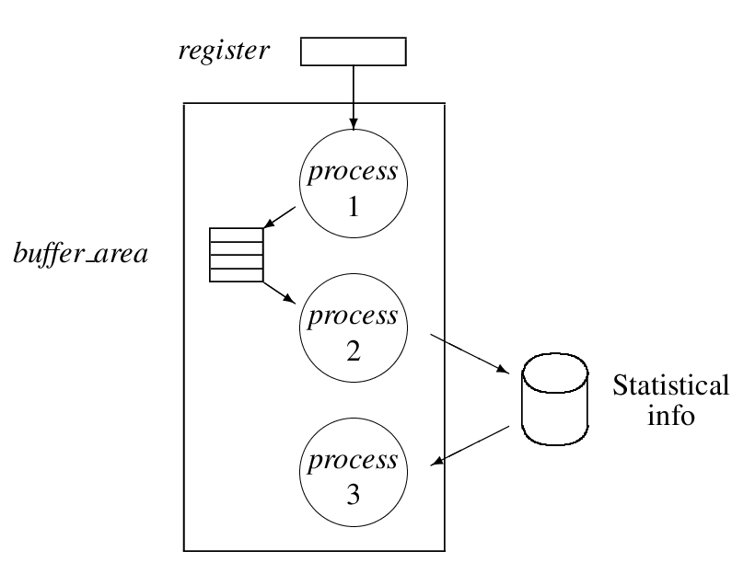
Tasks in the satellite data acquisition system

Slide 39
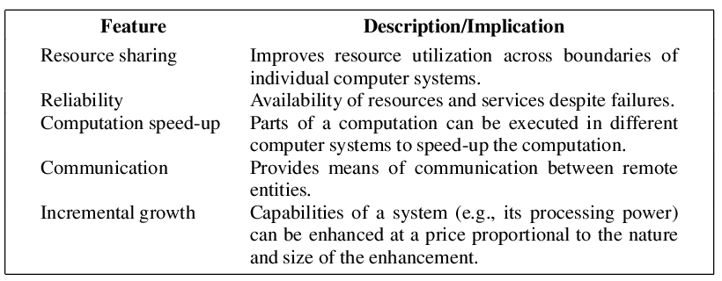
Features of distributed systems

Slide 40
Distributed system
What is a distributed computer system?
A distributed computer system consists of a number of computer systems, each having its own memory and performing some of the control functions of the OS
Each computer system is called a node, and the place where it is located is called a site

Slide 41
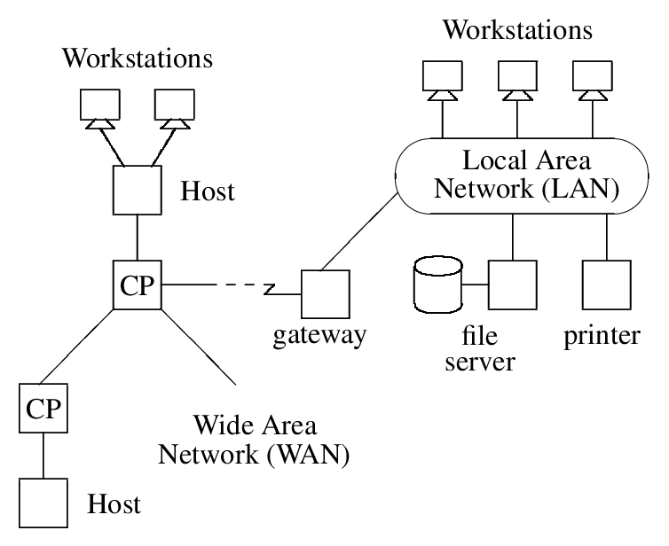
A distributed system

